Slide 1
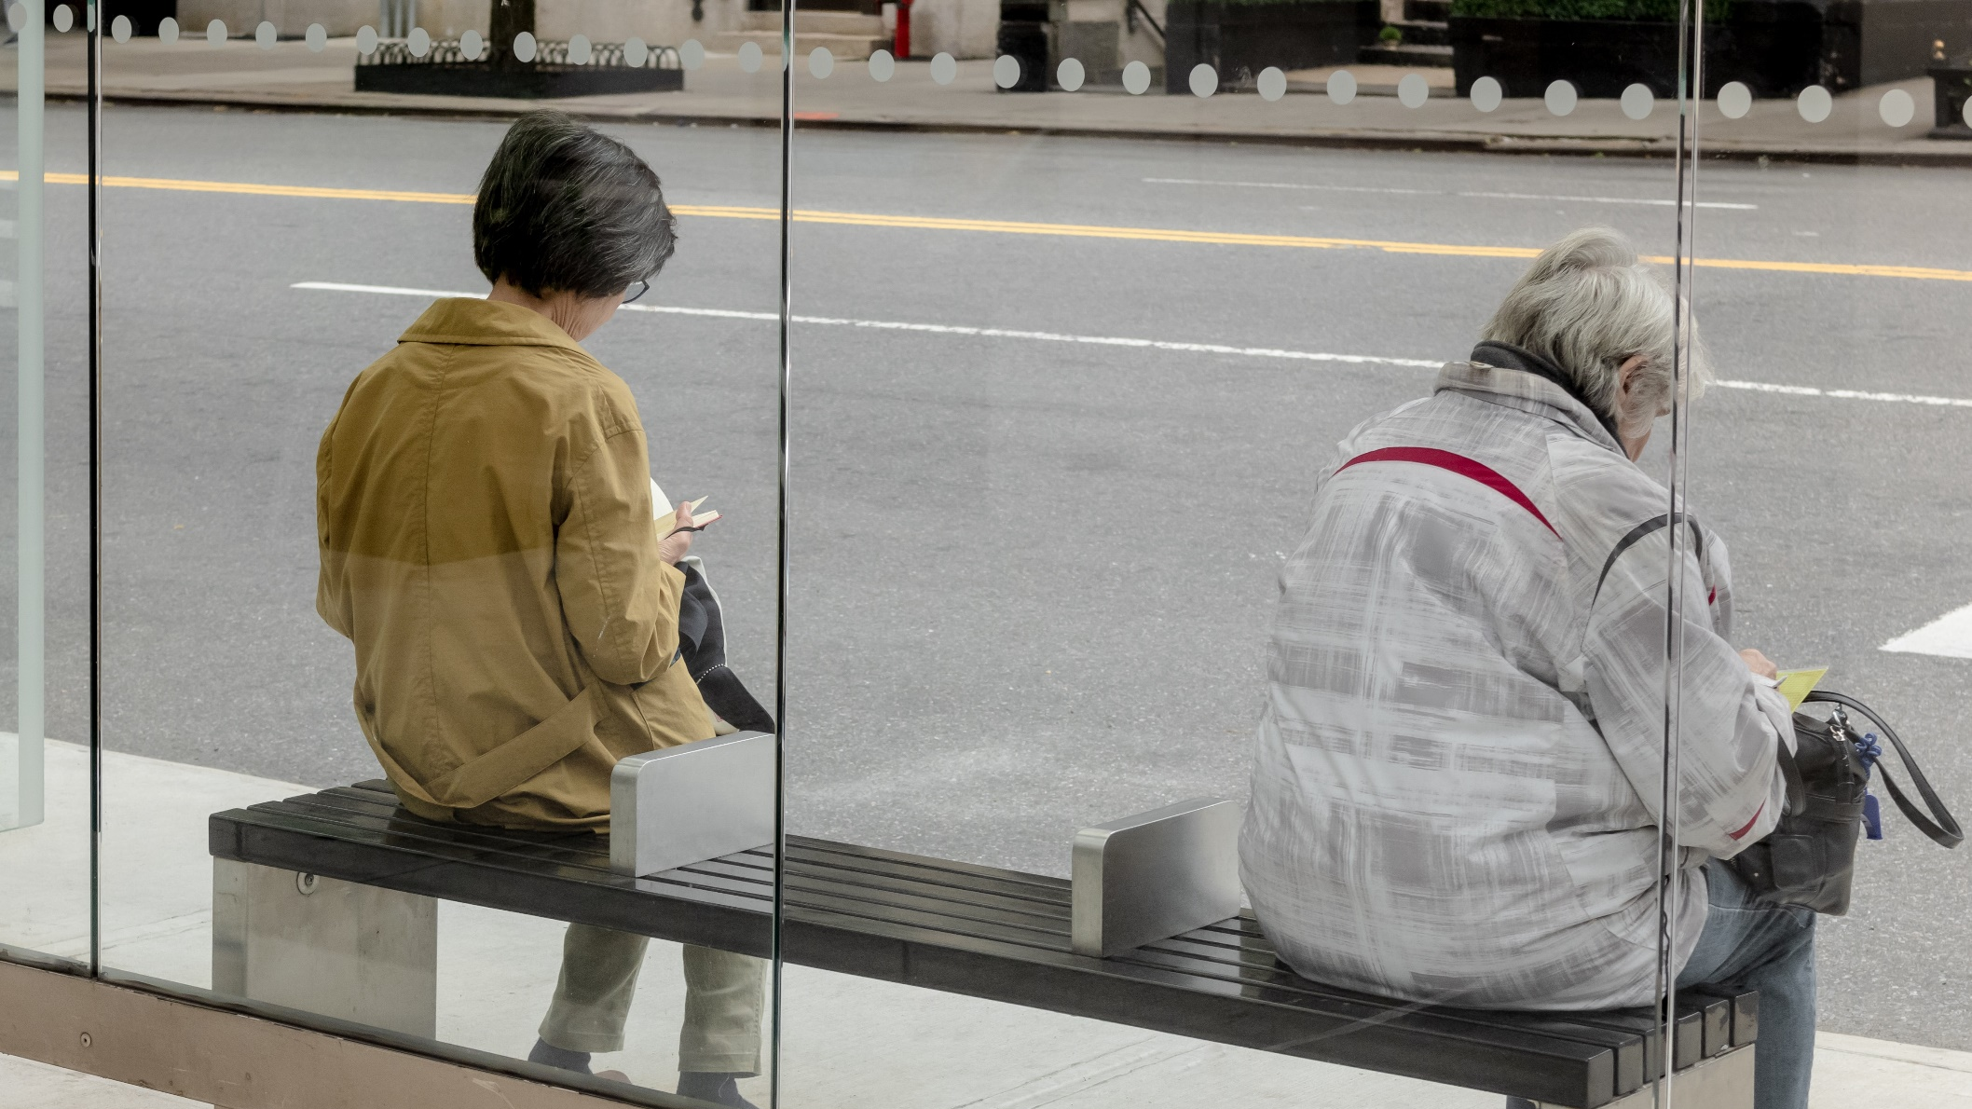
Did stringency measures influence happiness across the world over the course of the pandemic? Benjamin Strusch, Nils Müller, Svea Graupner

Slide 2
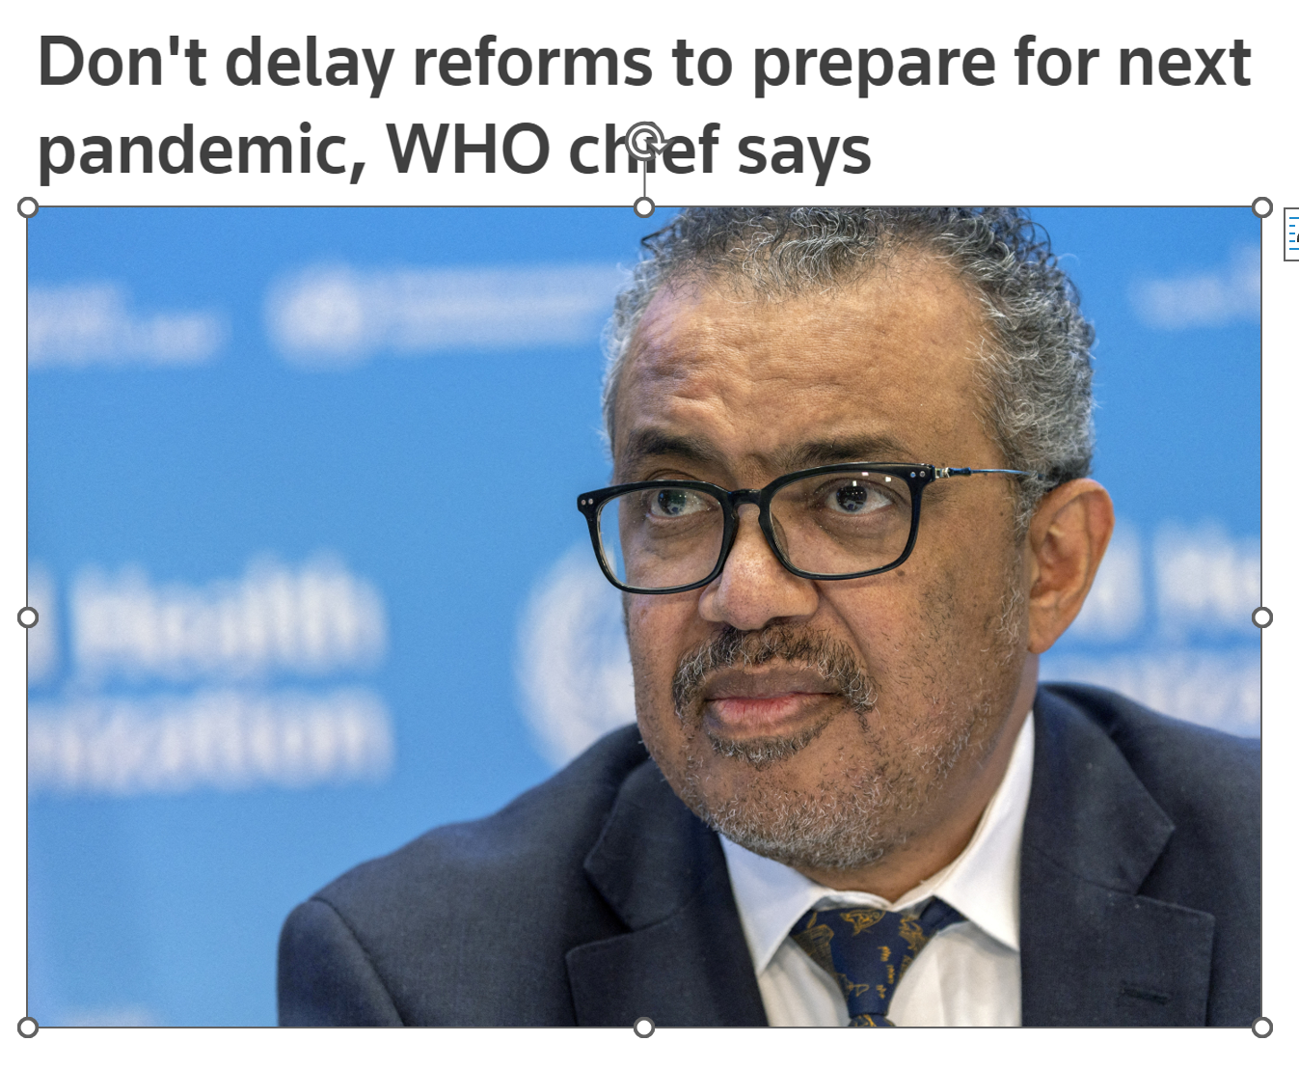


Did stringency influence happiness across the world over the course of the pandemic?

Slide 3
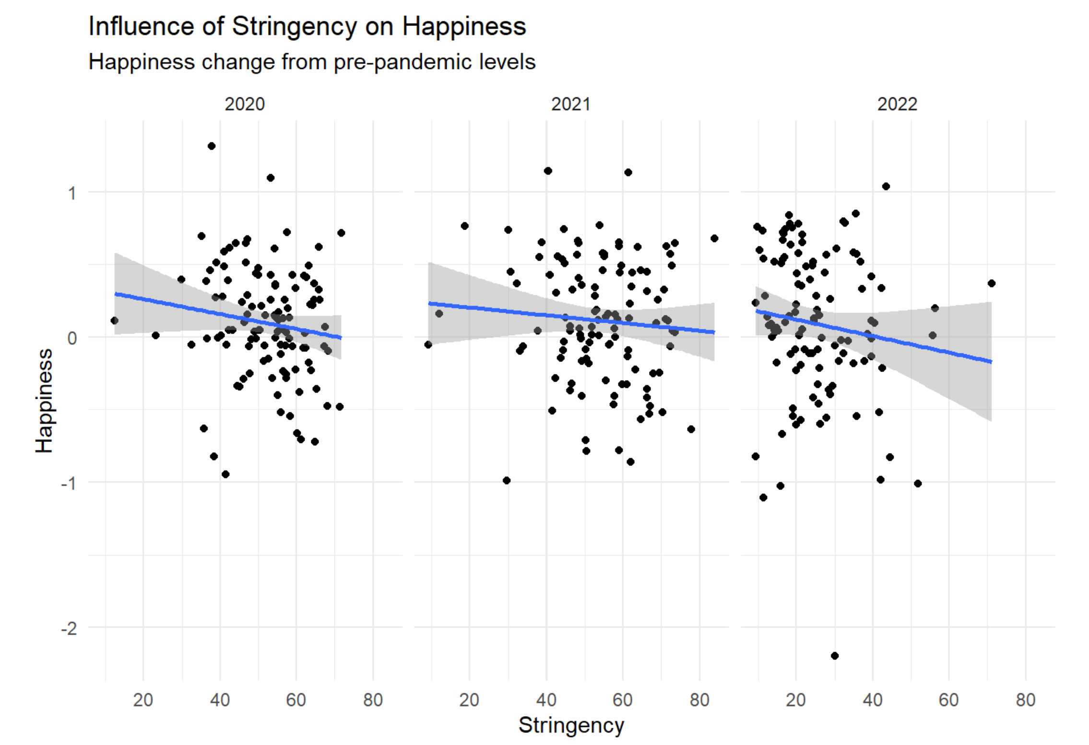

Slide 4





Slide 5




Slide 6

Thank you!

